Slide 1

Midterm Results
DSBA 6190-U90 | Colby T. Ford, Ph.D.

Slide 2
Overall Performance
Average: 188.9 (94.45%)
Median: 192 (96%)
Best Score: 202 (101%)
Worst Score: 165 (82.5%)
Worst Question: SA4
Best Question: Matching

Slide 3
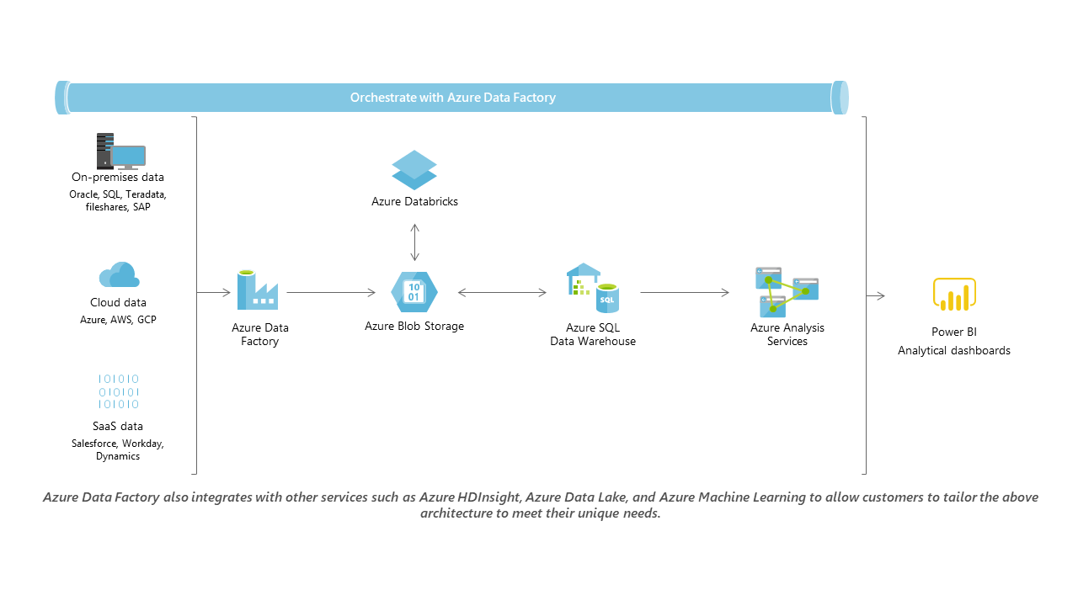
This is a reference architecture, not the ONLY architecture…

Slide 4
